Slide 1

Internet usage
COMMUNITY SERVICE PROJECT
Location : Ramesampeta

Slide 2

MENTOR : Mrs . Jalligampala Divya Lalitha Sri
Team Members :
Abir Basak -21P31A0568
Akshat Kumar Sinha - 21P31A0570
Amir Hamza - 21P31A0571
Bibhab Das - 21P31A0575
Dwipendu Kundu - 21P31A0581
Kunal Kanti Saha - 21P31A0594
Sheik Rizwan - 21P31A05B5
Narni Sai Jeevan - 21P31A0557
Abhishek Kumar - 21P31A0567

Slide 3
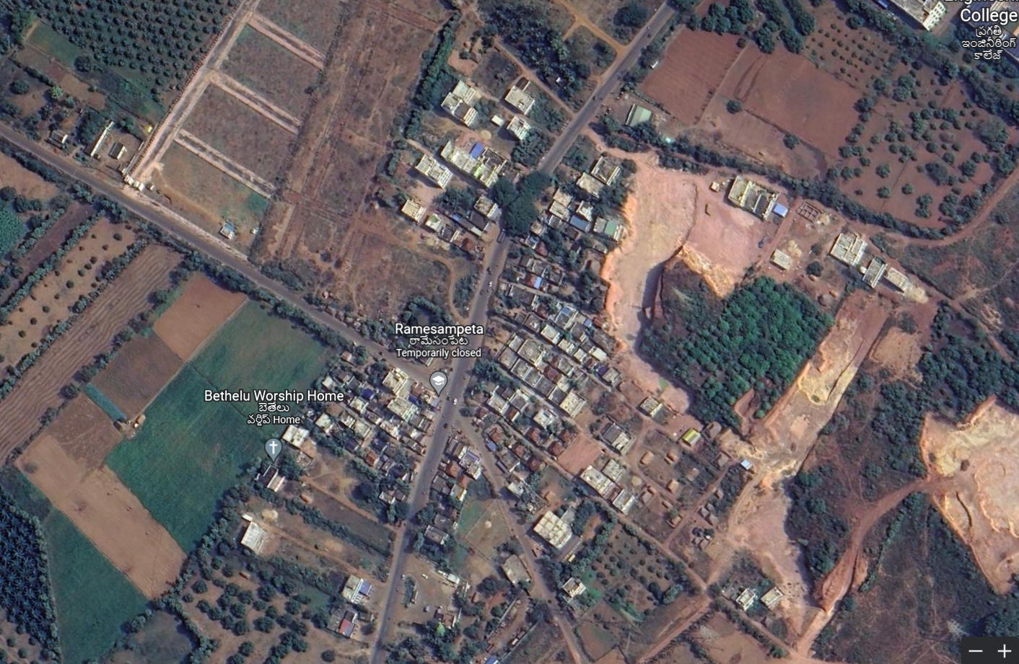
Introduction to village
Why Ramesampeta?
Ramesampeta is a village is 2.9 km near to Surampalem.
The total population of this village is about 1218 .
Males are 600.
Females are 618.
There are 306 houses.
Literacy Rate – 76.14%
Total area of this village is 313 Hectares.

Slide 4
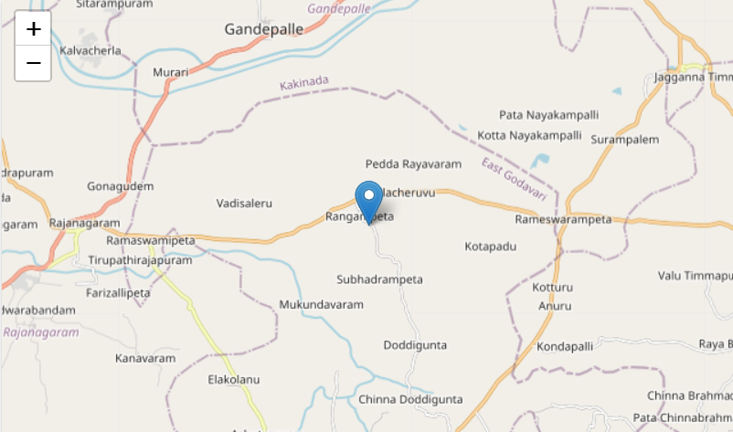
Ramesampeta Geographical details:
Longitude: 81.988930 East
Latitude : 17.081636 North
District: East Godavari
State: Andhra Pradesh
Country: India

Slide 5
Introduction to project
Our project is about Internet usage in a village.
We have taken the surveys from the villagers about their knowledge on the internet and tried to make them aware about :-
What is internet
why it is important
what are the security measures we have to take while surfing though internet ,etc.
And also to know what are issues they are facing while using the internet.

Slide 6
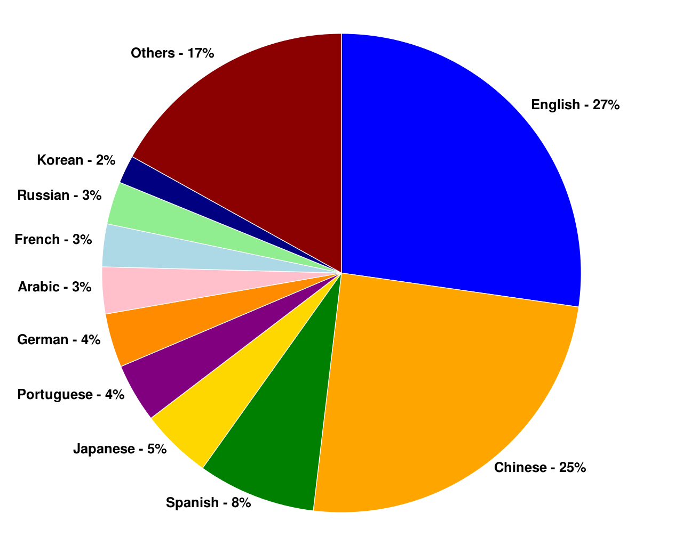
INternet
Internet is the collection of millions of computers around the world that are well
connected to one another. It is a Global network of computers.
Here is the usage of internet by language

Slide 7

SURVEY
We take survey from the peoples of Ramesampeta to gather informtion
We take these survey in Google-form
Due to Google-form it takes lesser time to take the survey

Slide 8
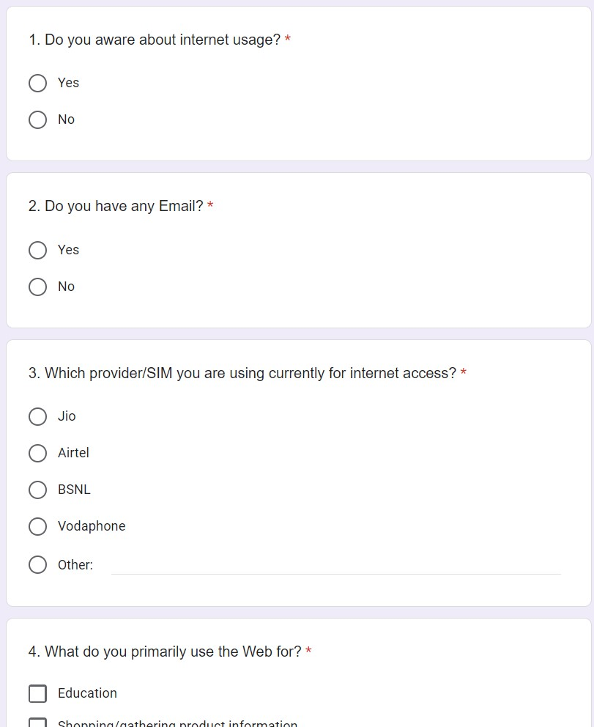
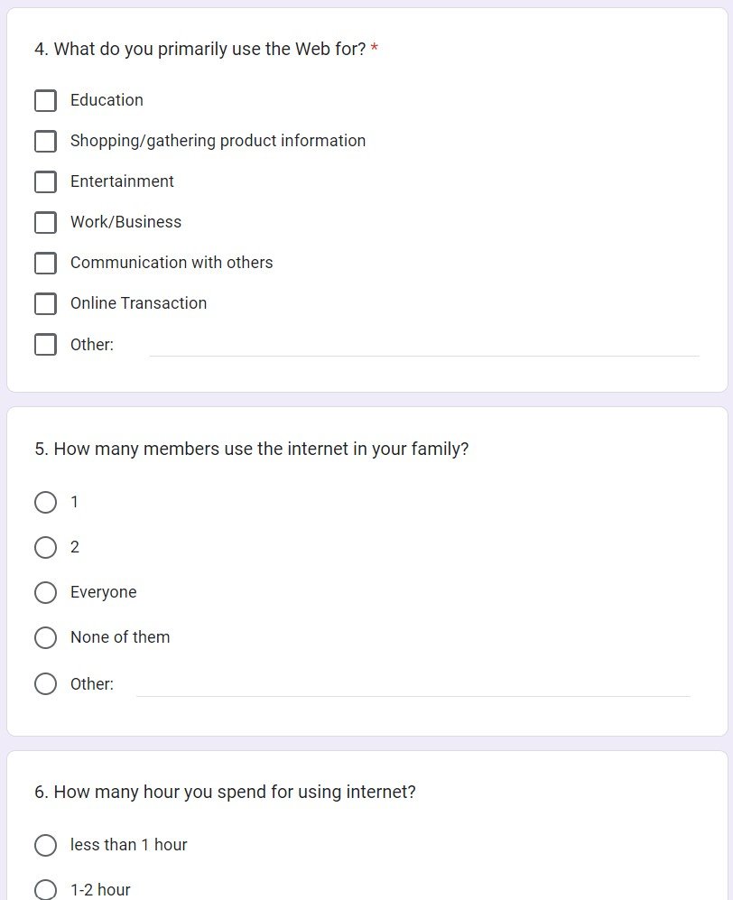
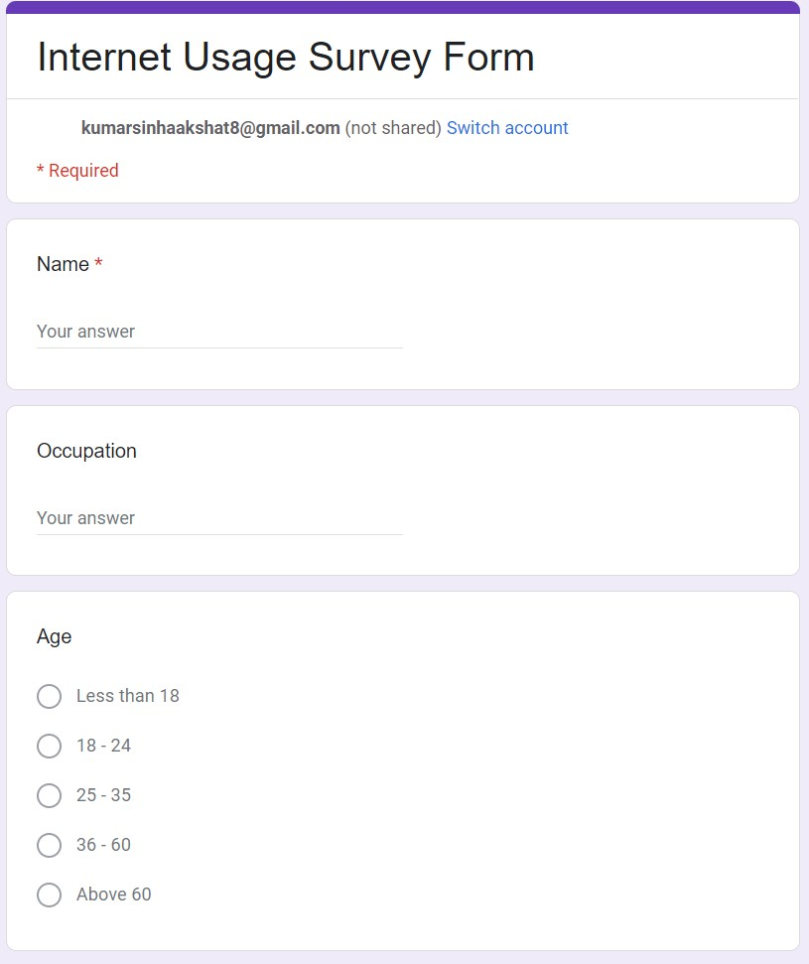
SURVEY FORM QUESTIONS:-

Slide 9
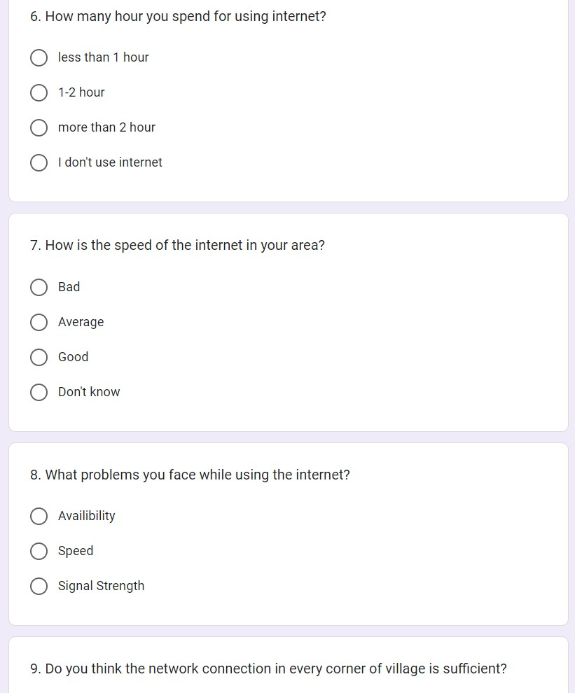
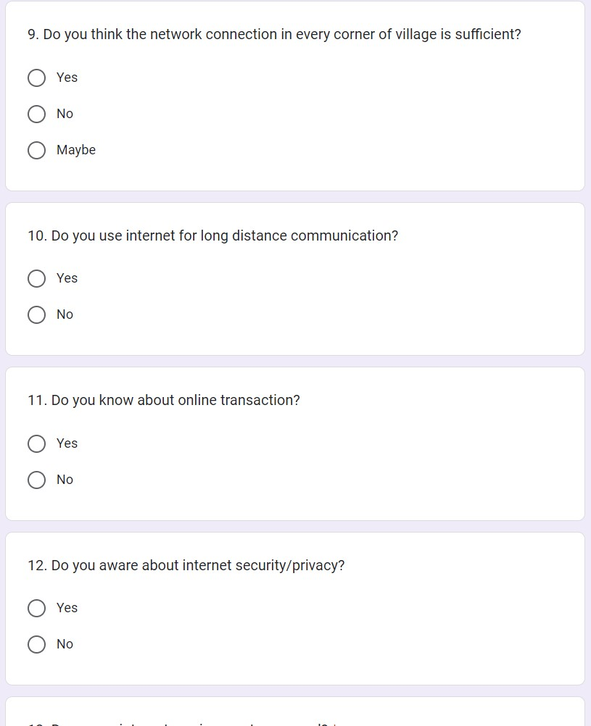
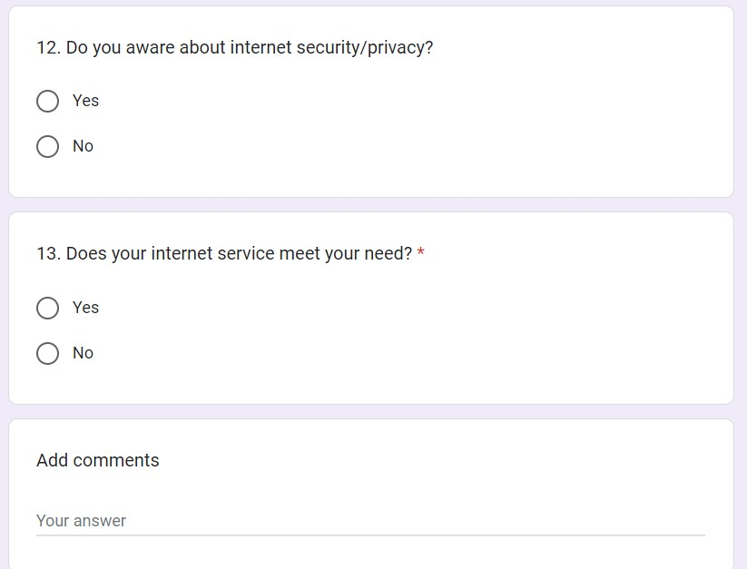

Slide 10
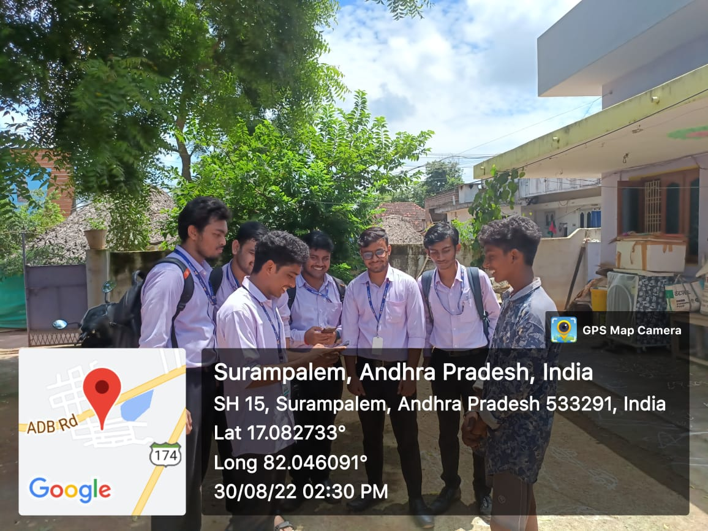
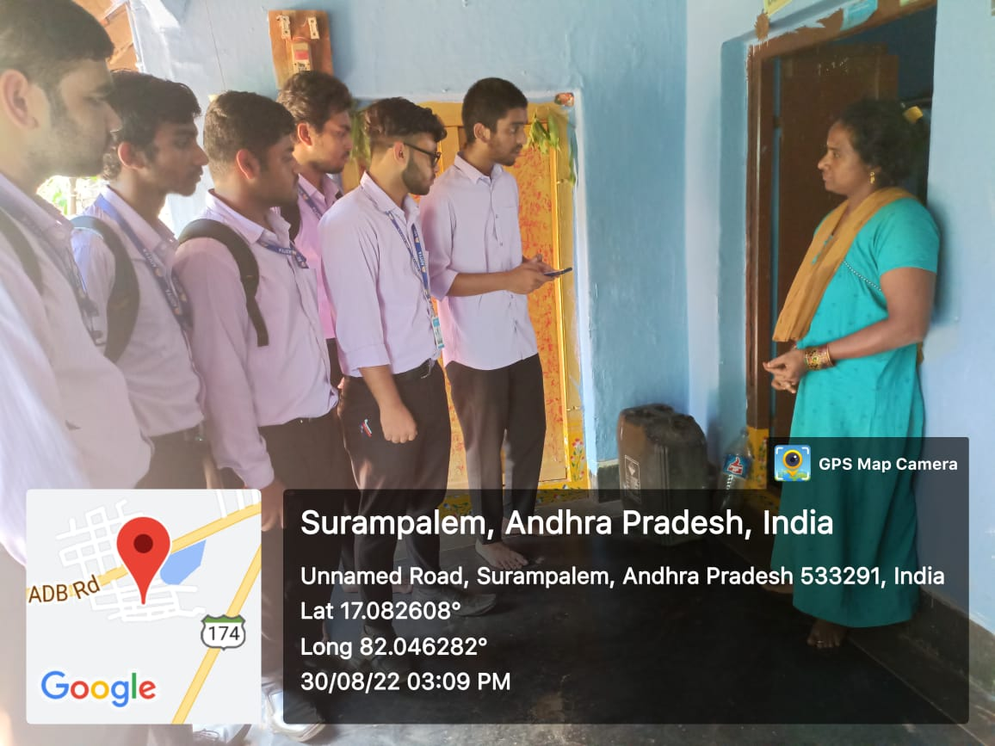
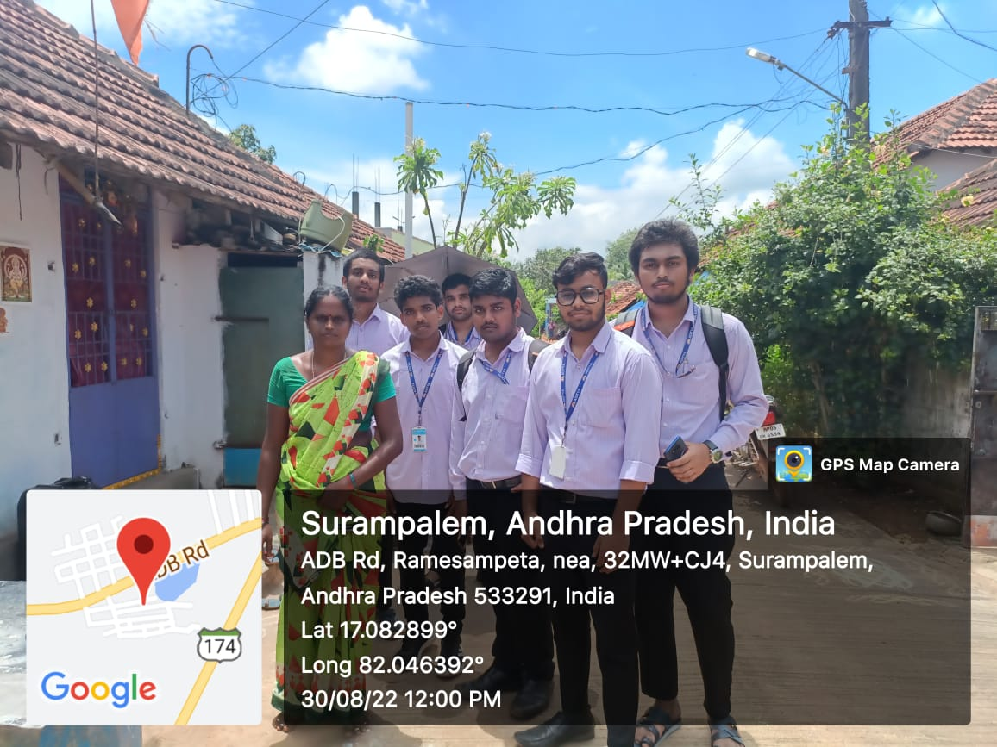
Surveys taken by our Team Day – 1 date - 30/08/22
Visited 4 houses and intracted with 10 peoples from 10:00AM to 12:30PM
Visited 6 houses and intracted with 20 peoples from 02:00PM to 04:30PM

Slide 11
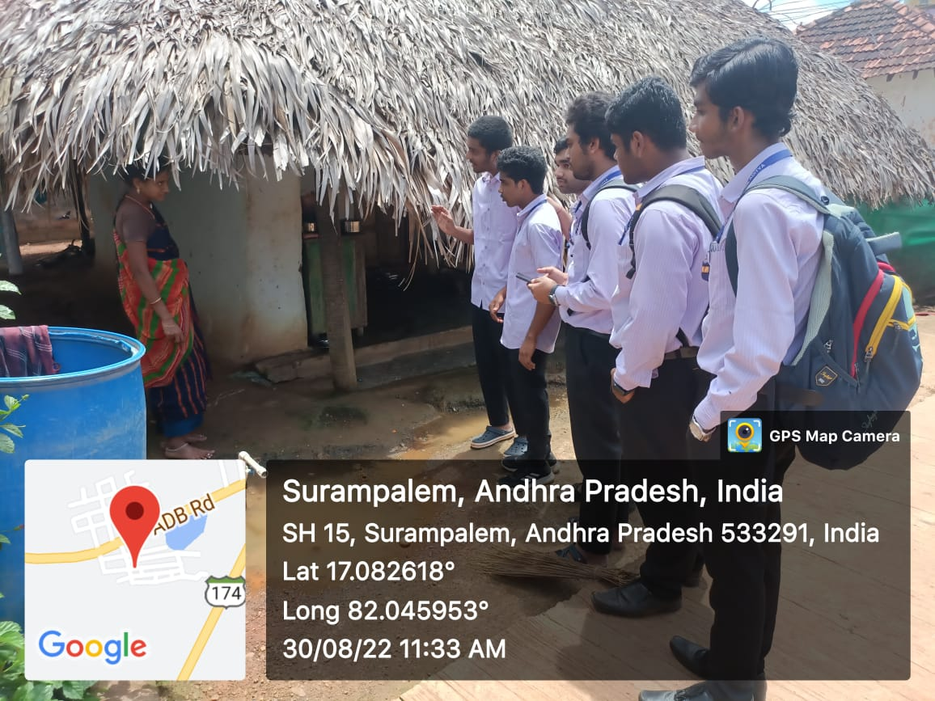
date - 30/08/22

Slide 12
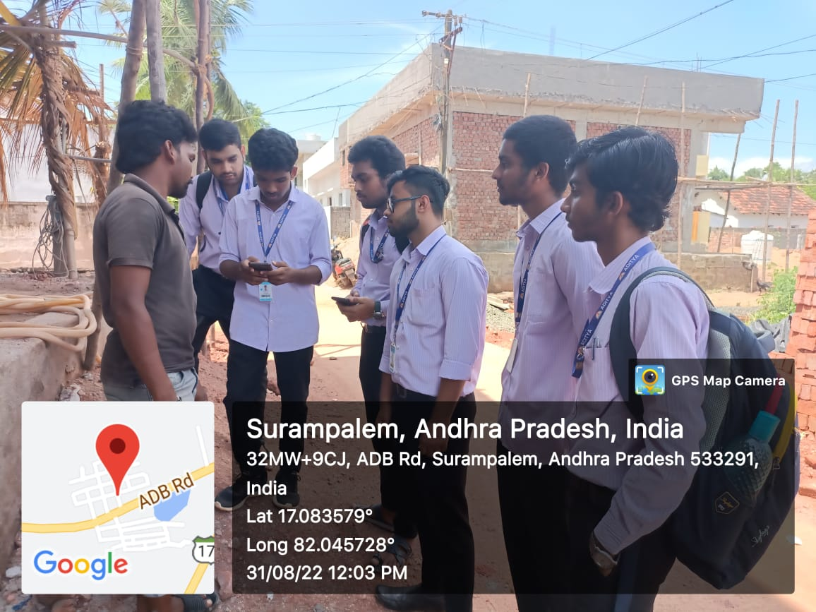
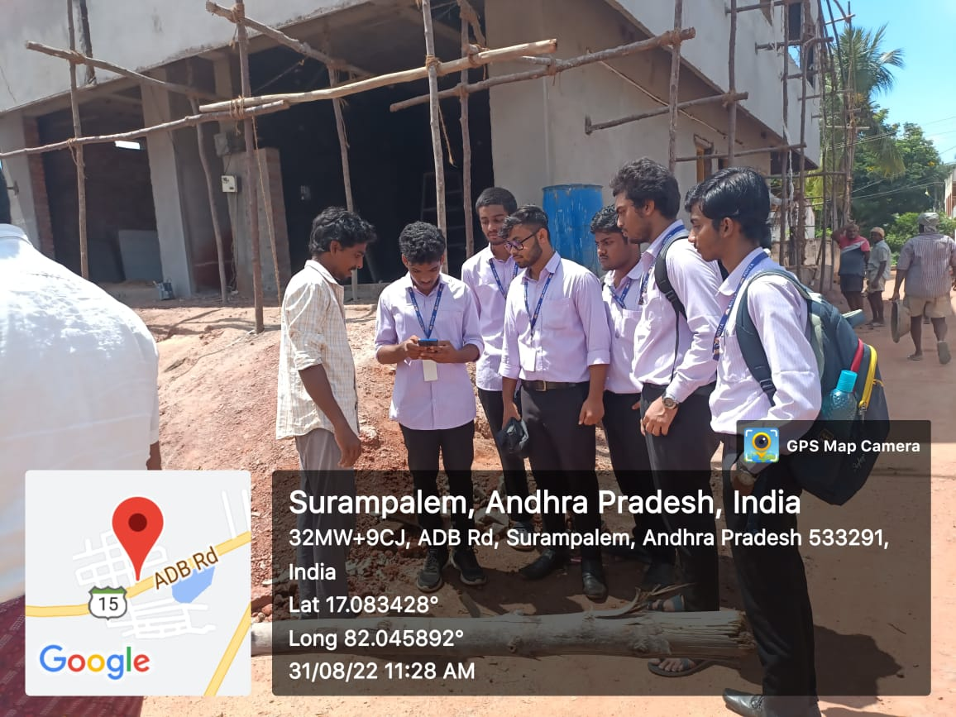
Day-2
DATE - 31/08/22
Visited 10 houses and intracted with 15 peoples from 10:00AM to 12:30PM
Visited 8 houses and intracted with 12 peoples from 02:00PM to 04:30PM

Slide 13
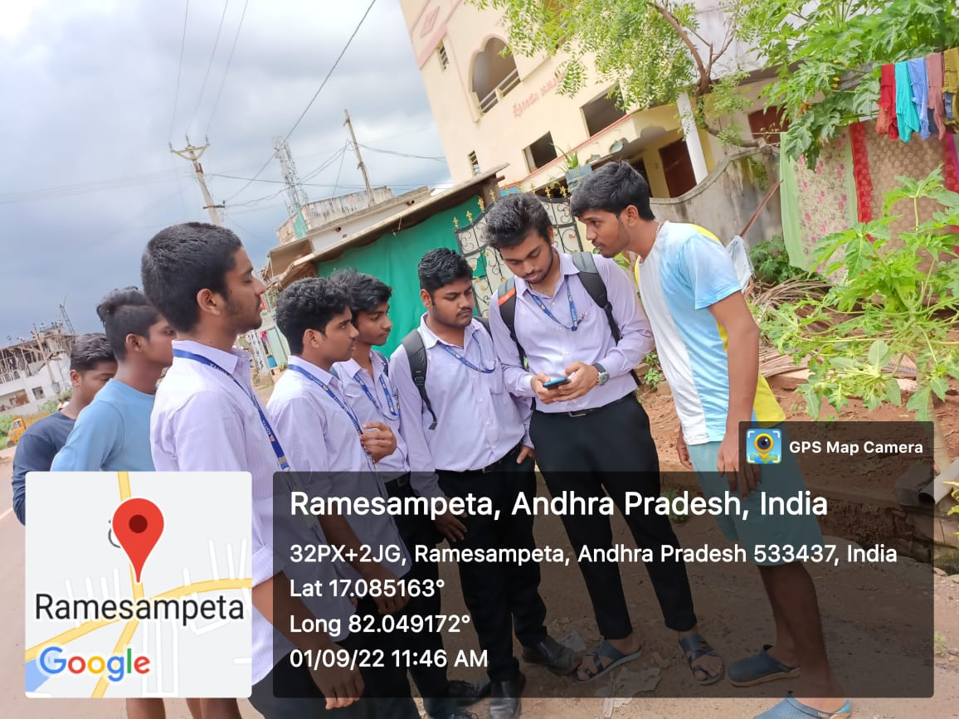
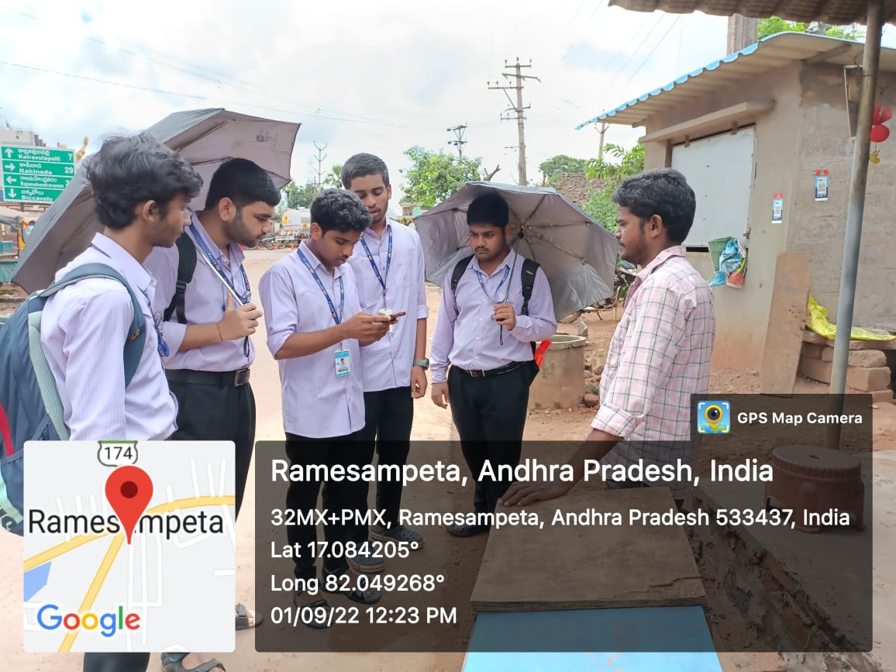
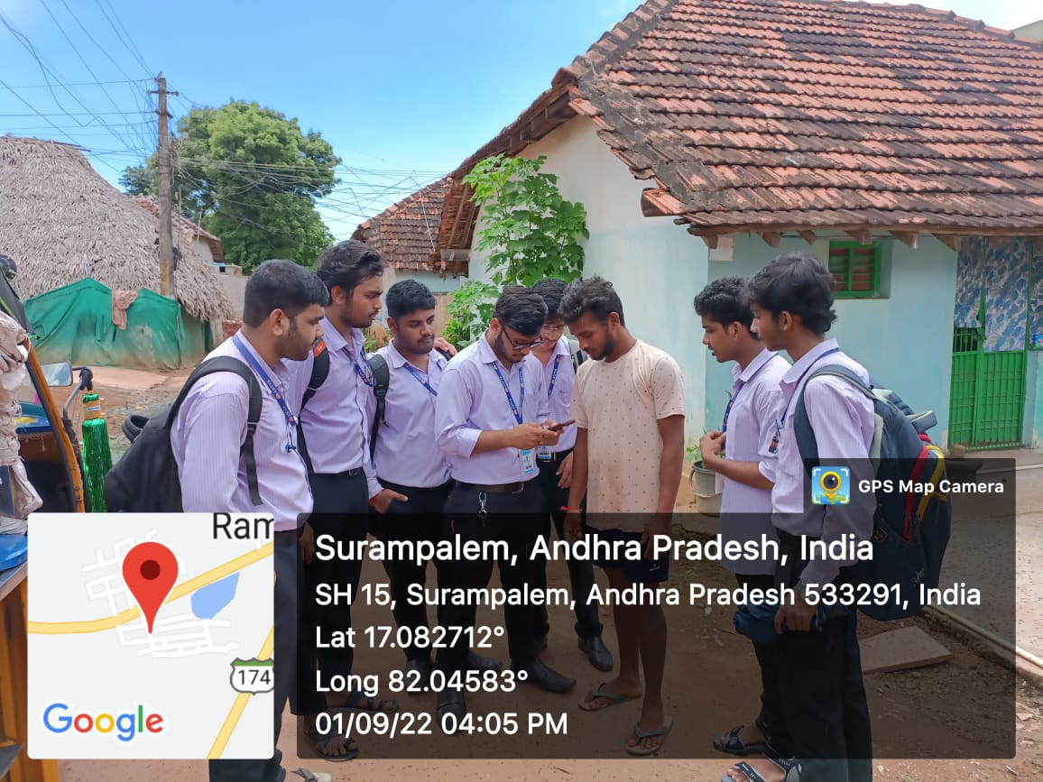
Day-3
DATE-01/09/22
Visited 9 houses and intracted with 13 peoples from 10:00AM to 12:30PM
Visited 10 houses and intracted with 15 peoples from 02:00PM to 04:30PM

Slide 14
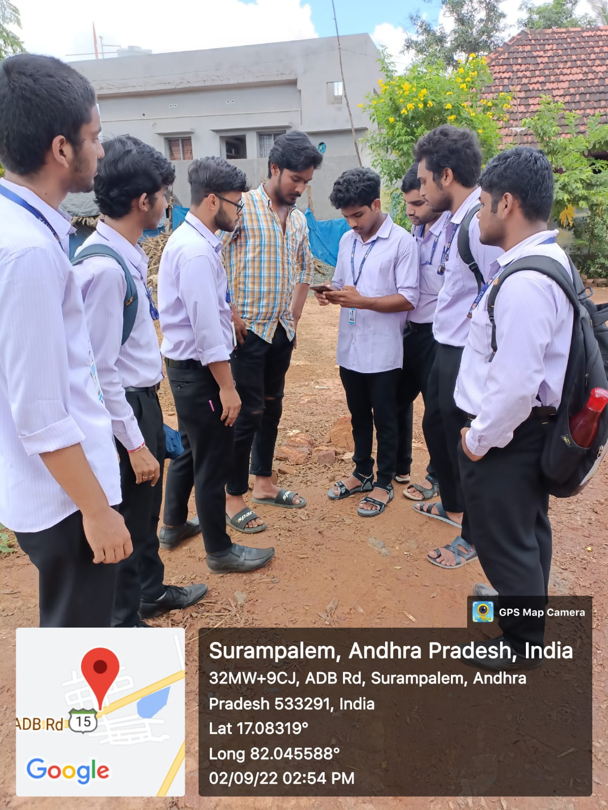
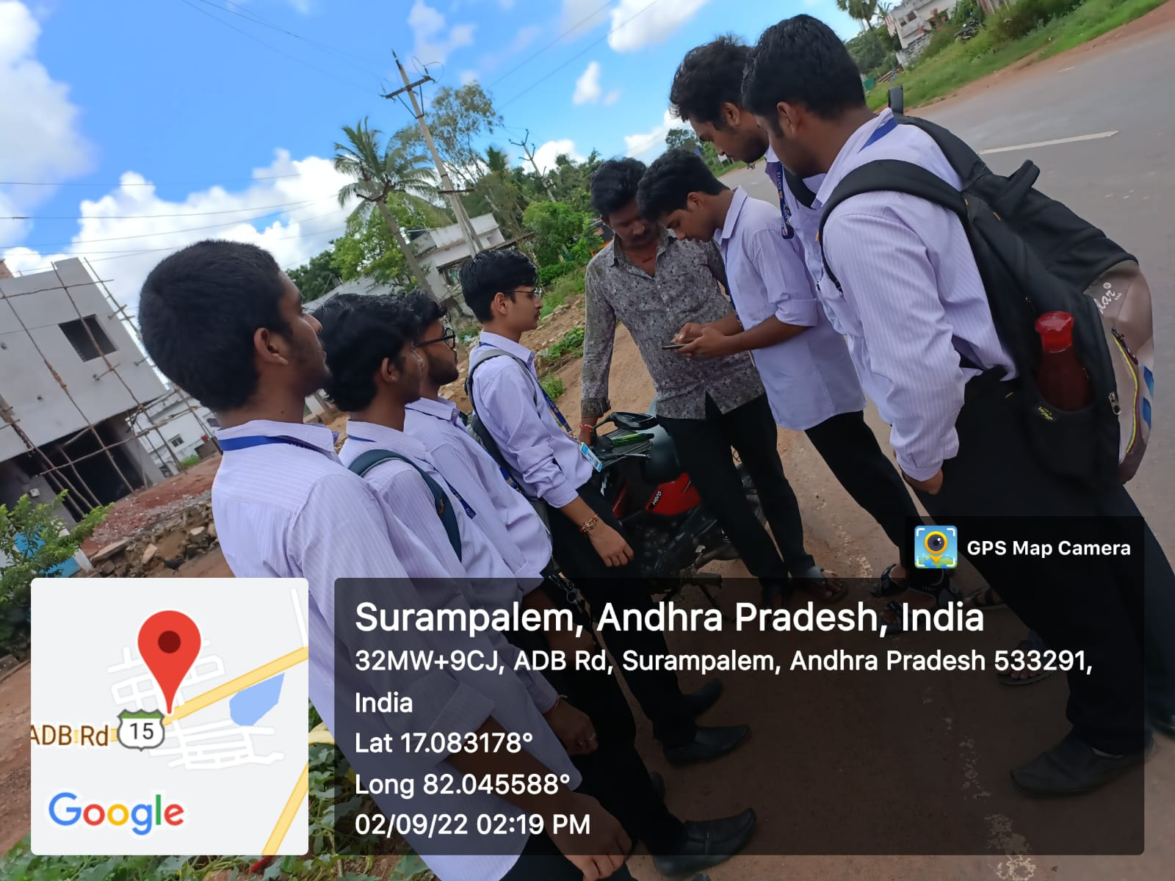
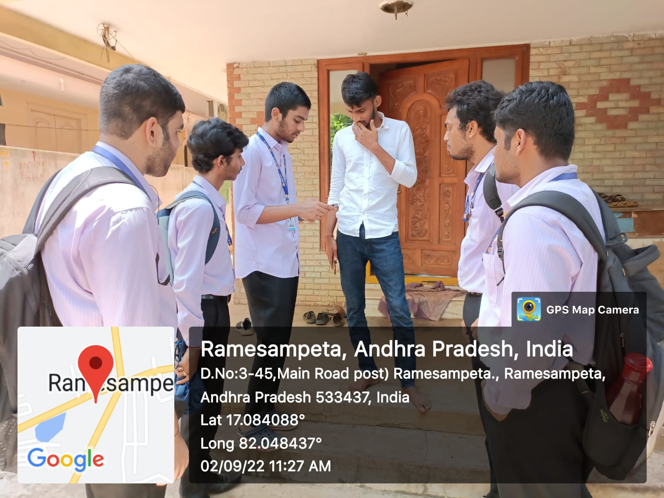
Day-4
DATE-02/09/22
Visited 10 houses and intracted with 15 peoples from 10:00AM to 12:30PM
Visited 10 houses and intracted with 20 peoples from 02:00PM to 04:30PM

Slide 15
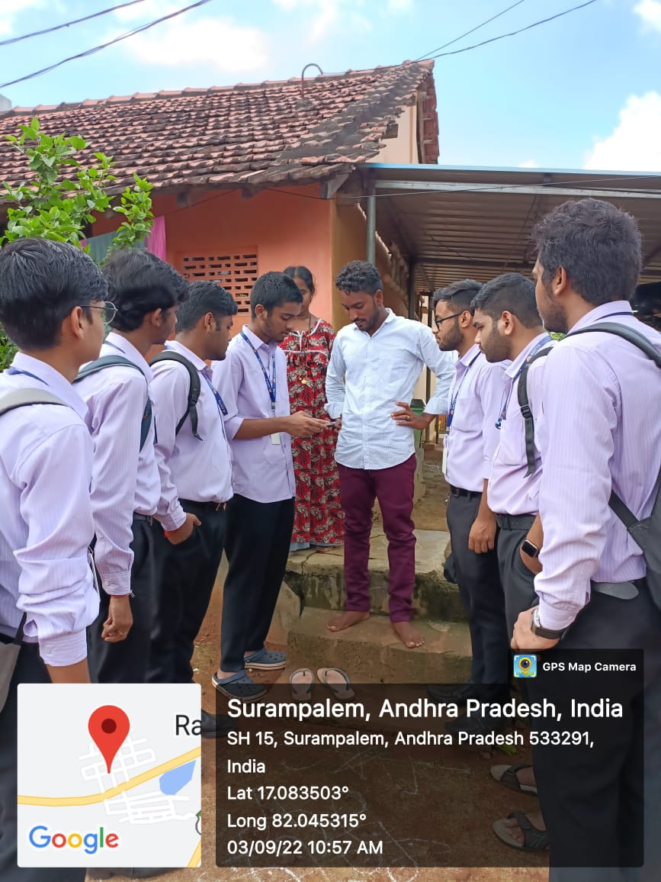
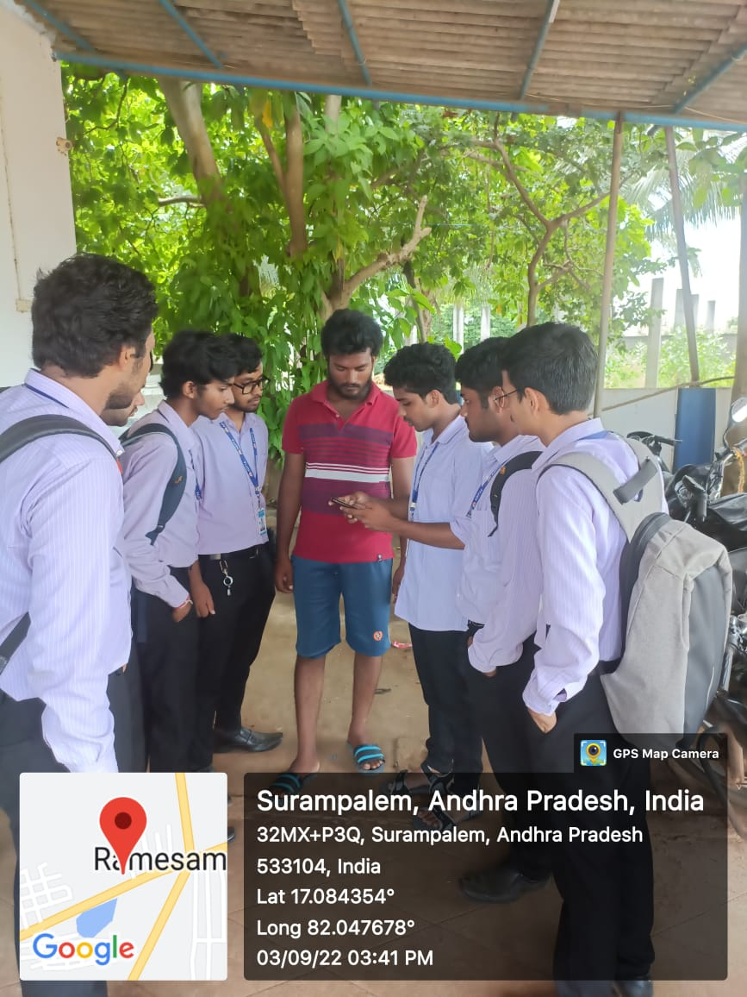
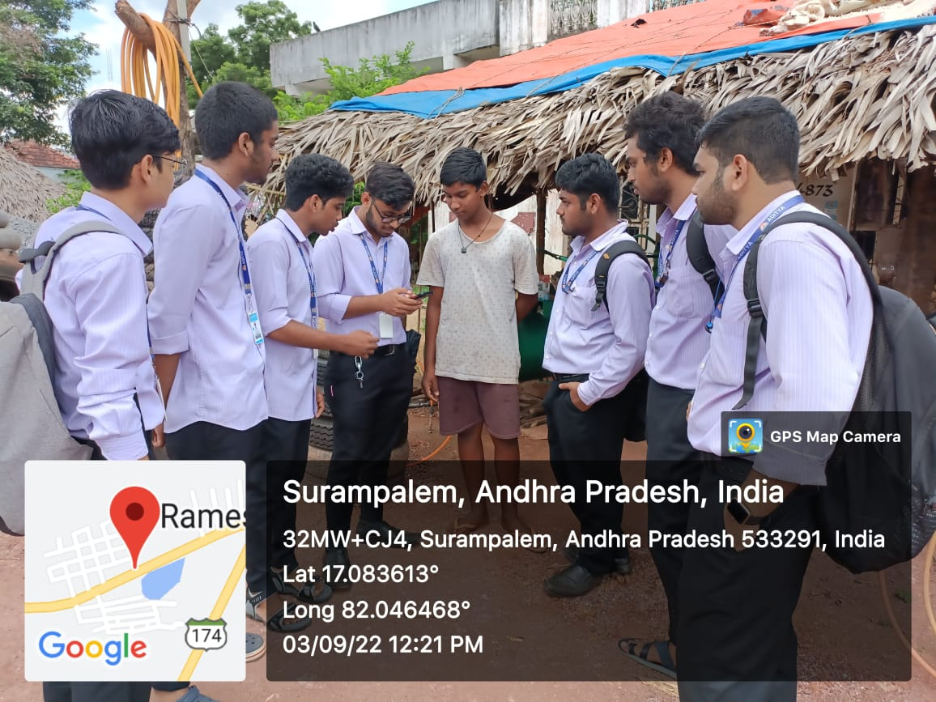
Day-5
DATE-03/09/22
Visited 10 houses and intracted with 15 peoples from 10:00AM to 12:30PM
Visited 10 houses and intracted with 10 peoples from 02:00PM to 04:30PM

Slide 16
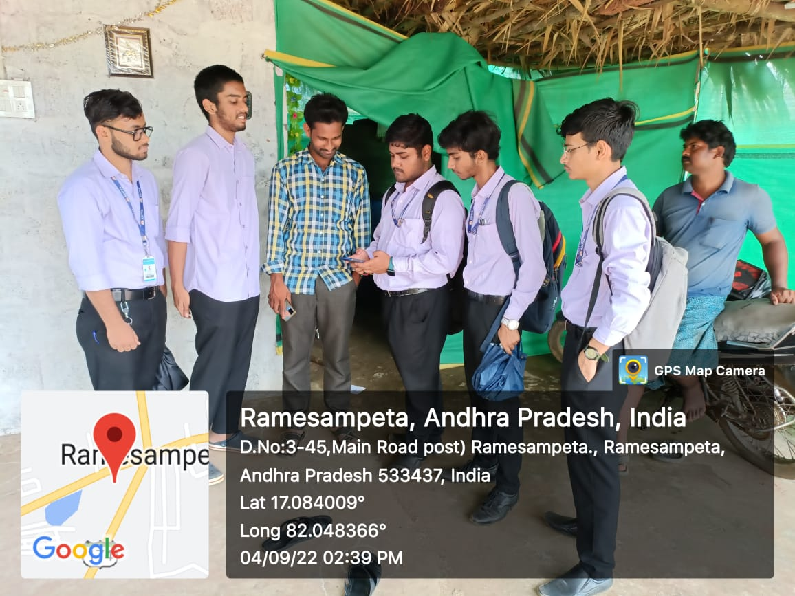
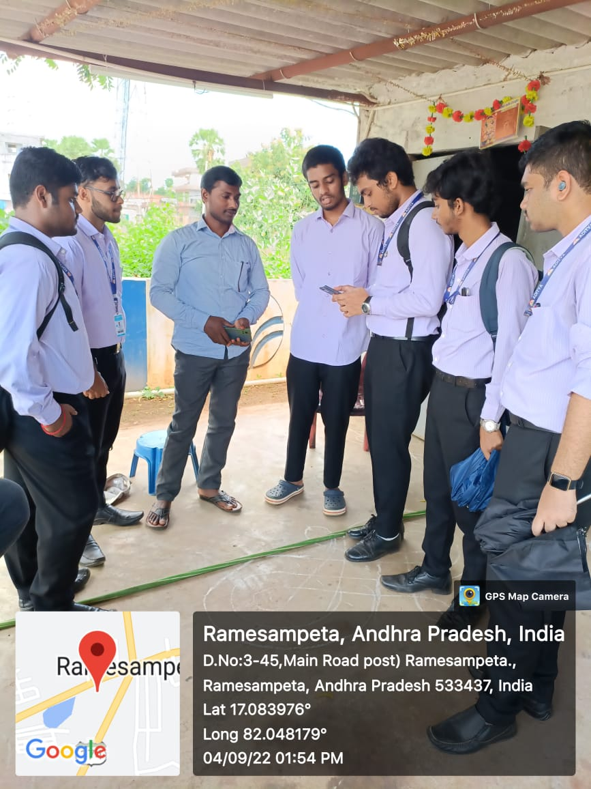
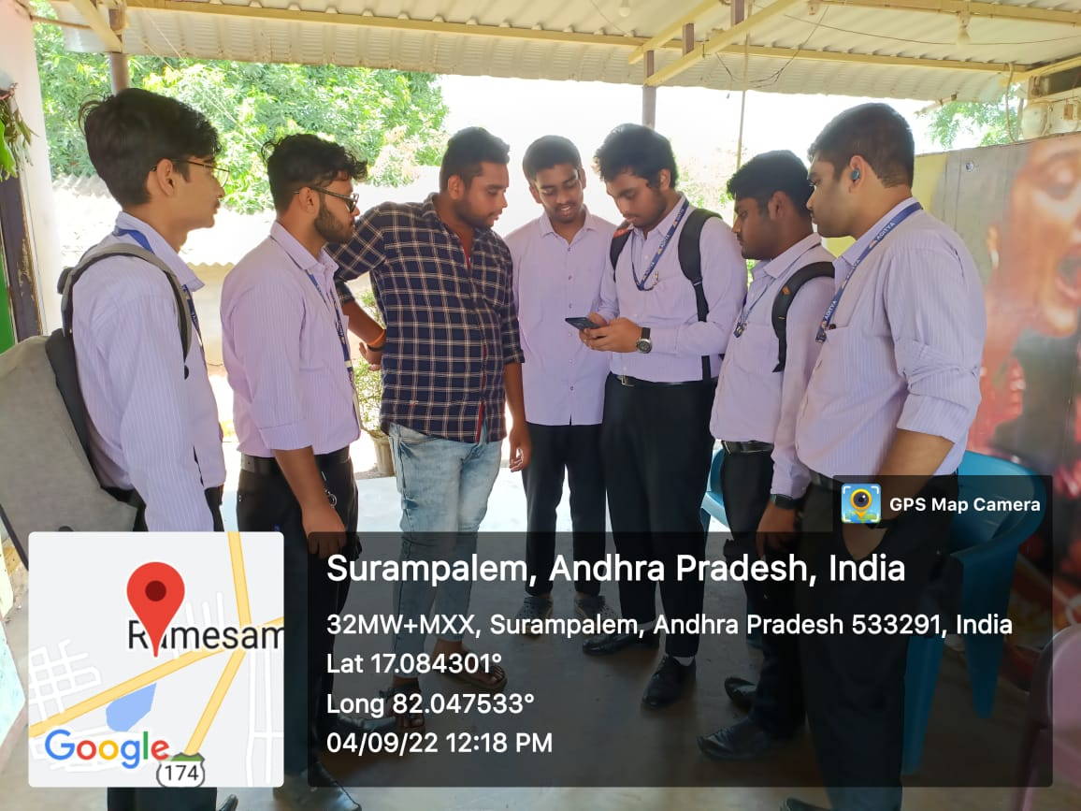
Day-6
DATE-04/09/22
Visited 12 houses and intracted with 25 peoples from 10:00AM to 12:30PM
Visited 13 houses and intracted with 25 peoples from 02:00PM to 04:30PM

Slide 17
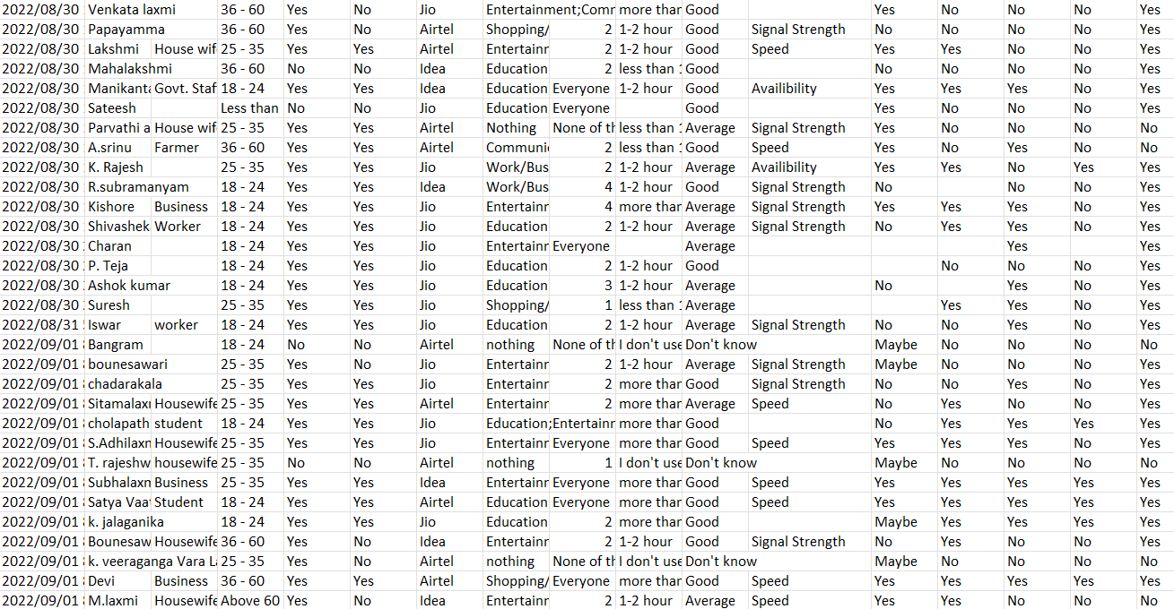
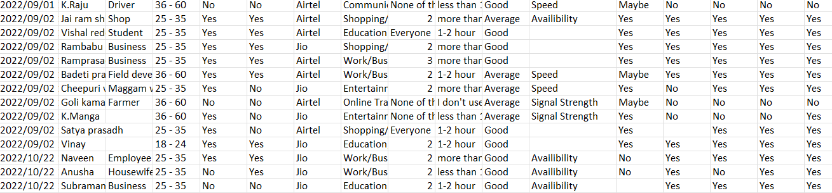
WE GOT 70+ RESPONSES

Slide 18
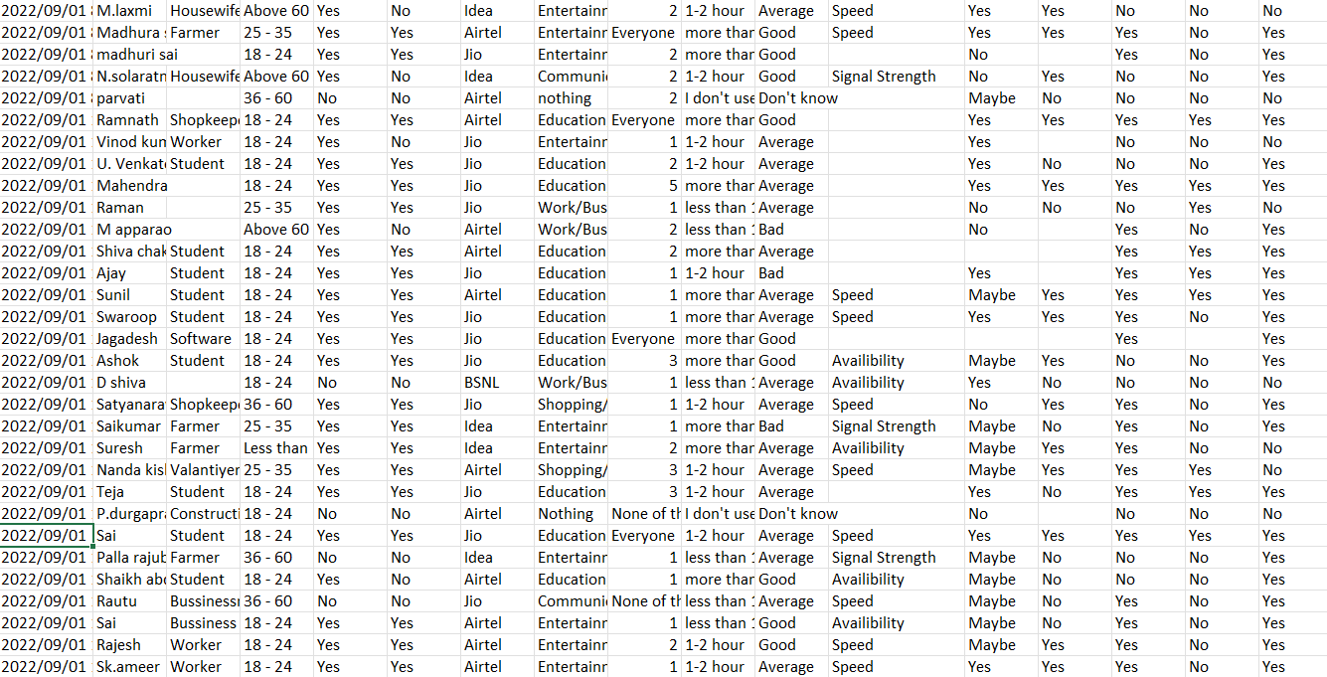
THESE ARE THE RESPONSES WE COLLECTED DURING SURVEY…

Slide 19
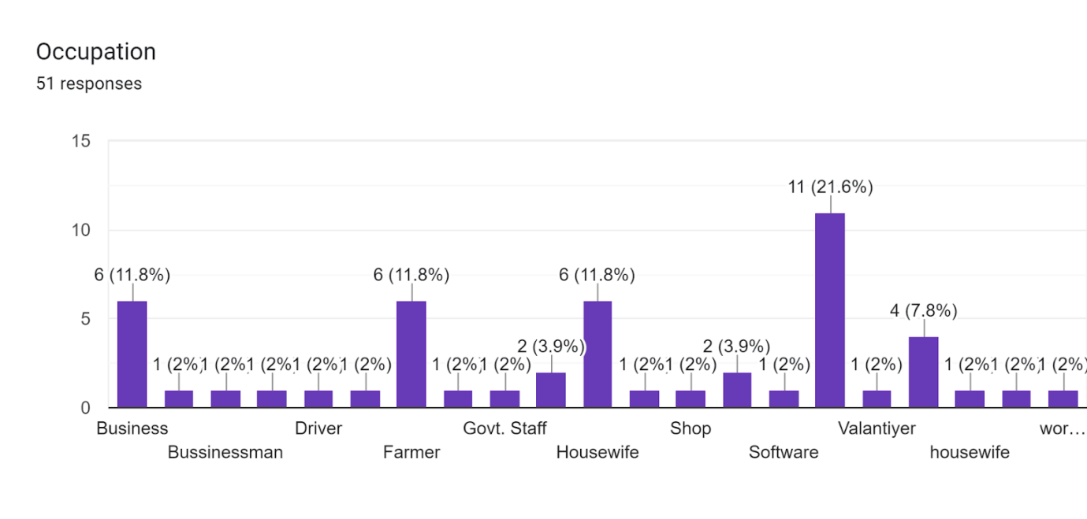
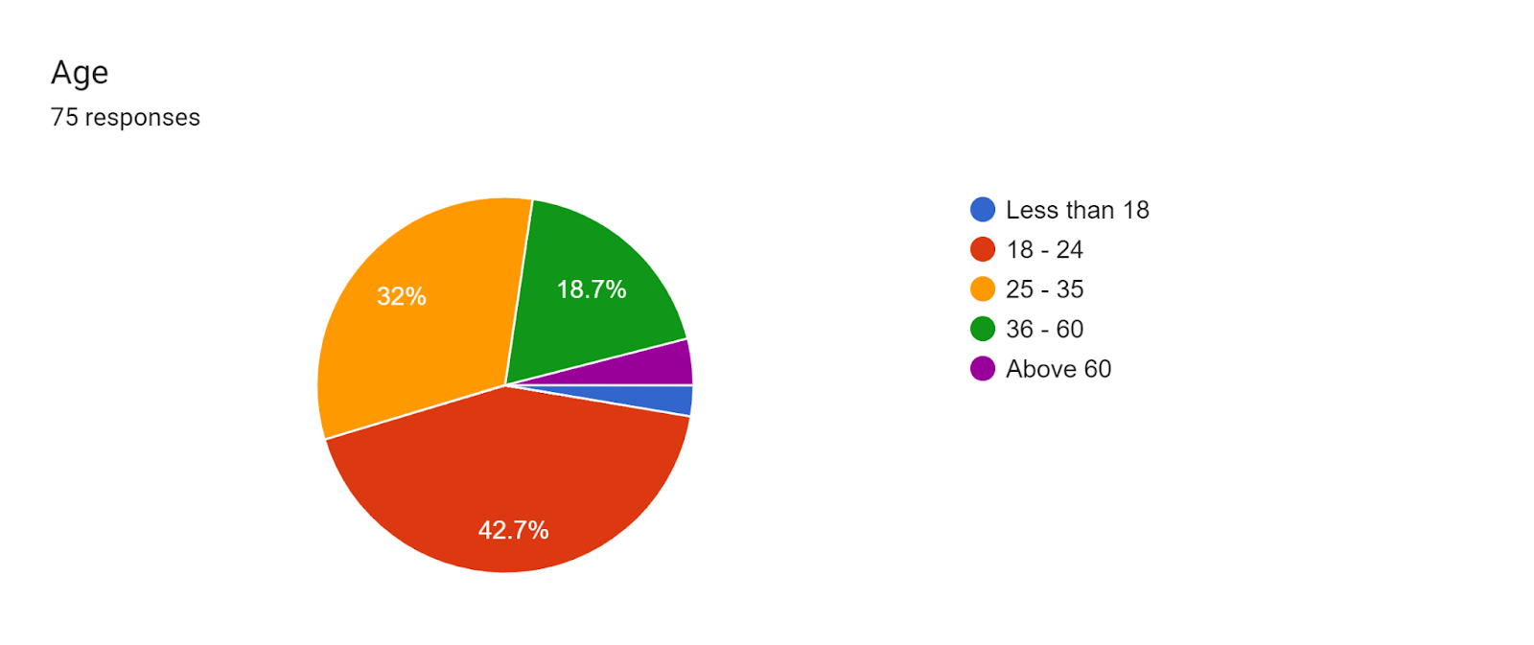
RESPONSES
OCUPATION:
EDUCATION:-21.6%(MAX)
2%(MIN)-DRIVER,SHOP,WORKER HOUSEWIFE,ETC

Slide 20
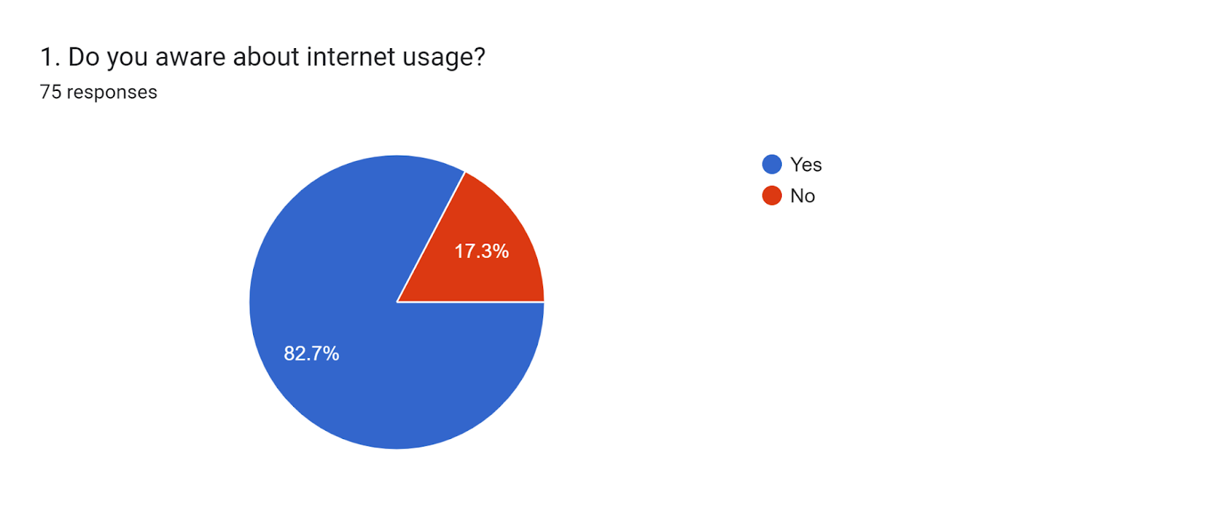
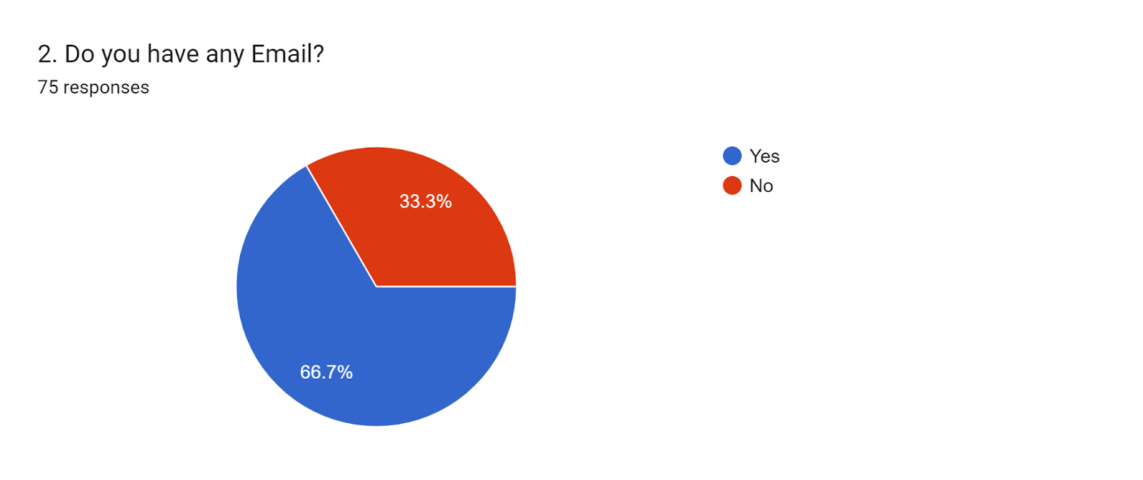
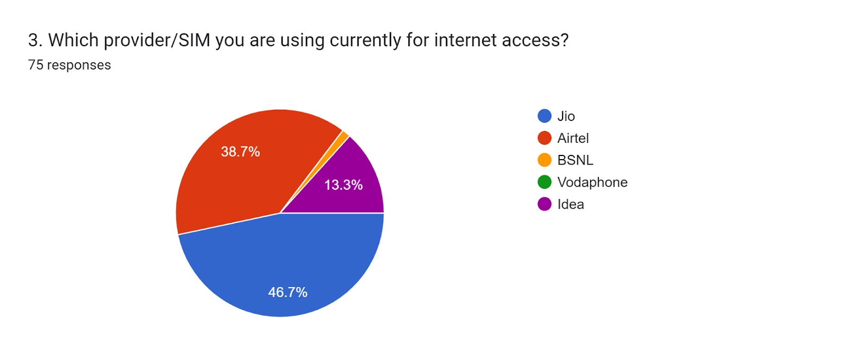

Slide 21
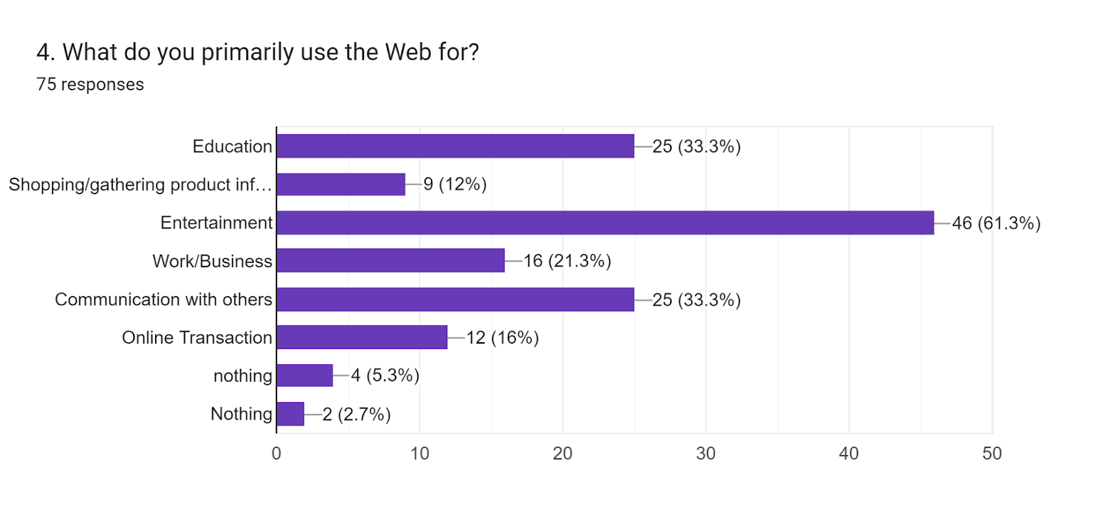
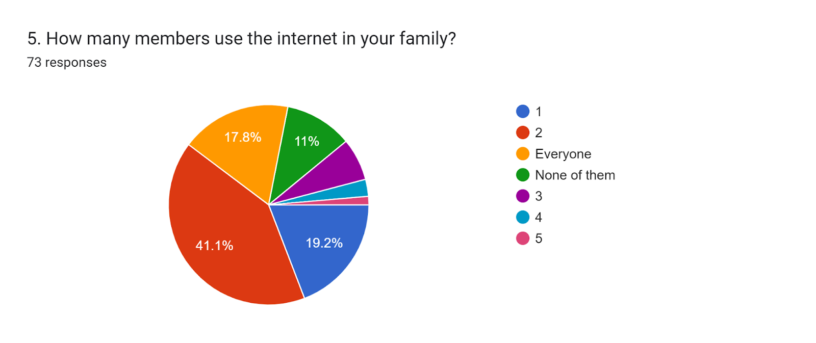
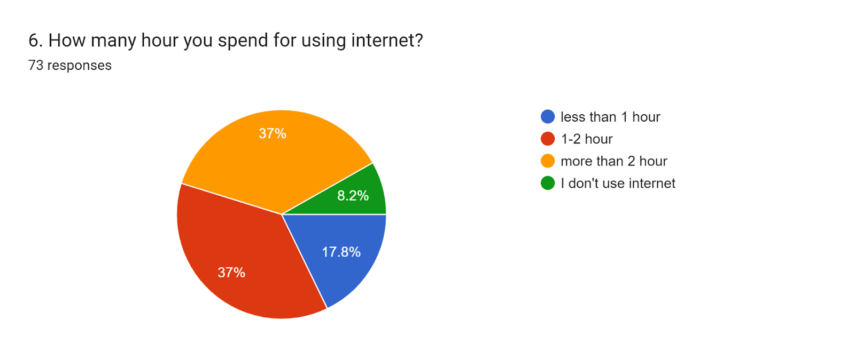

Slide 22
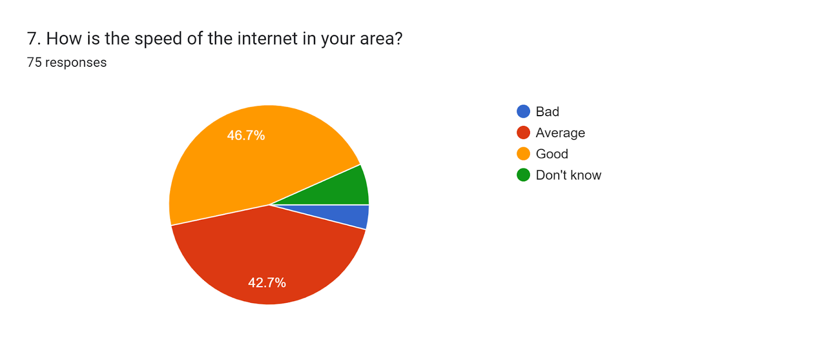
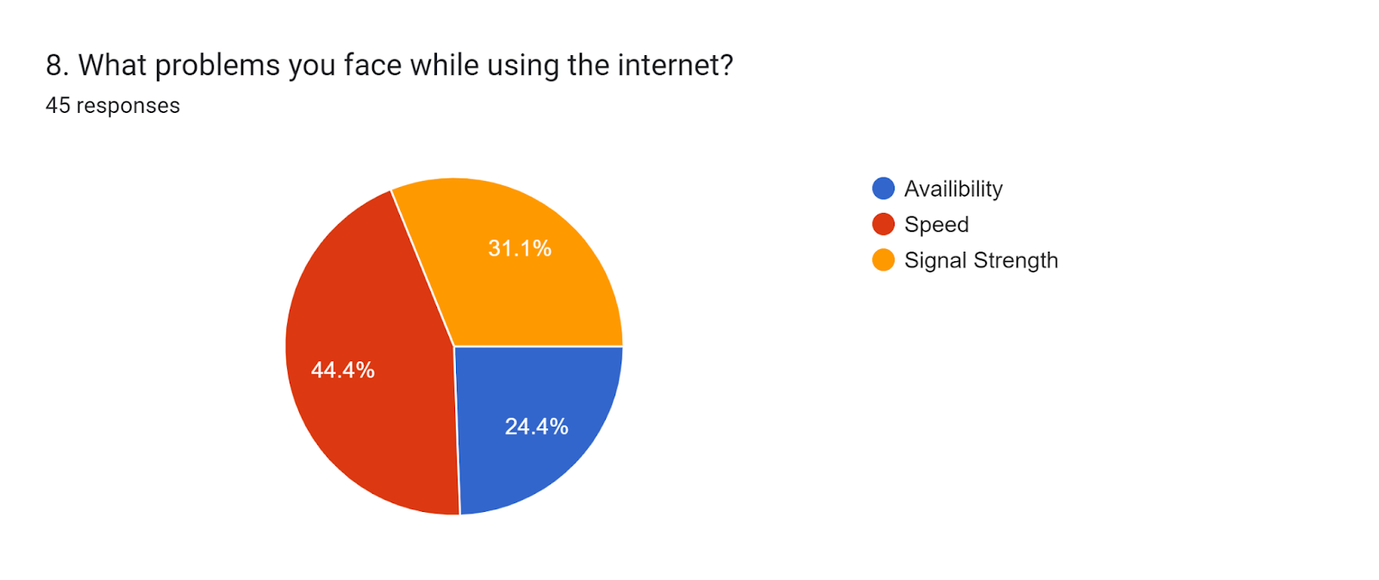
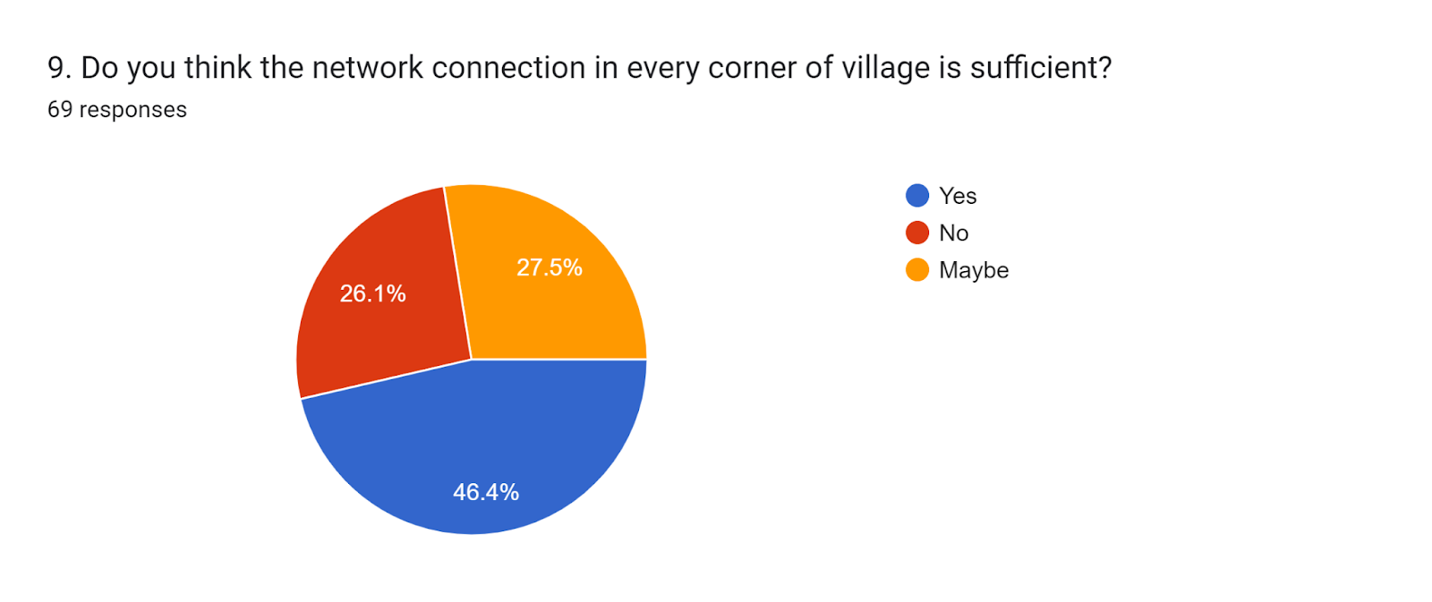
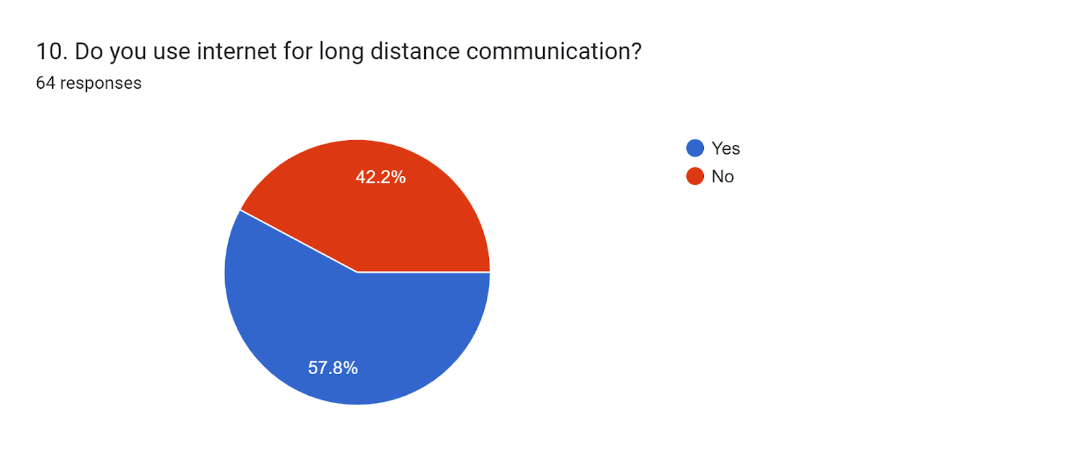

Slide 23
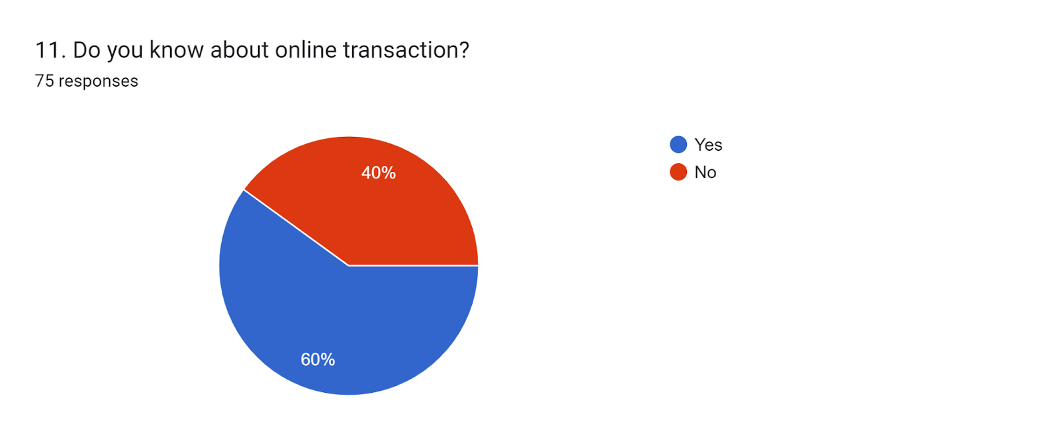
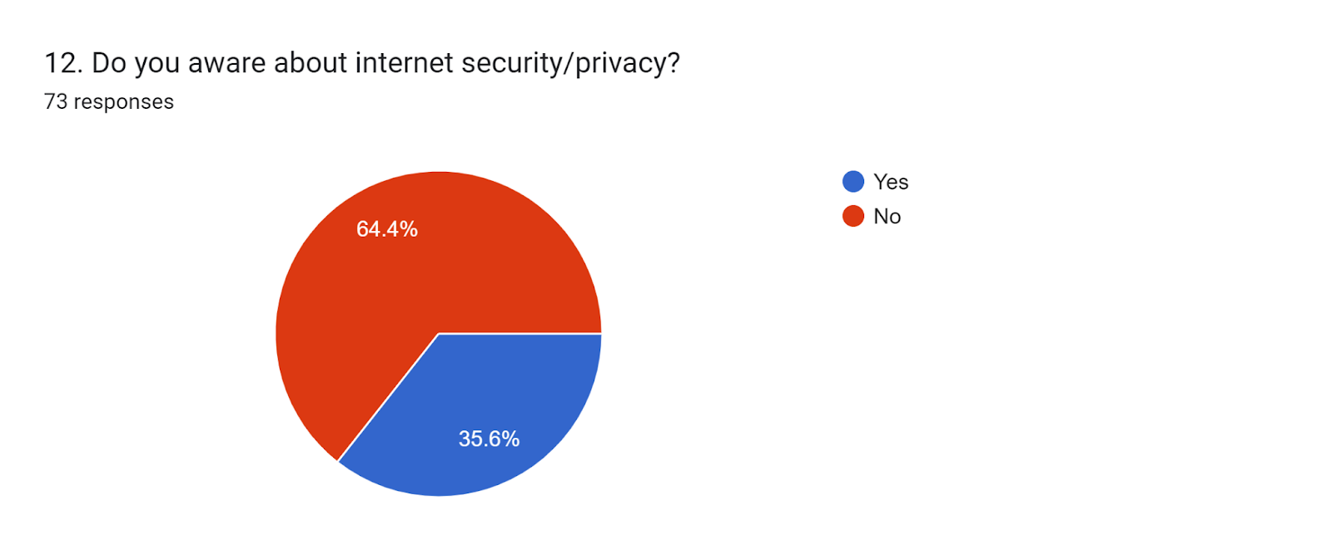
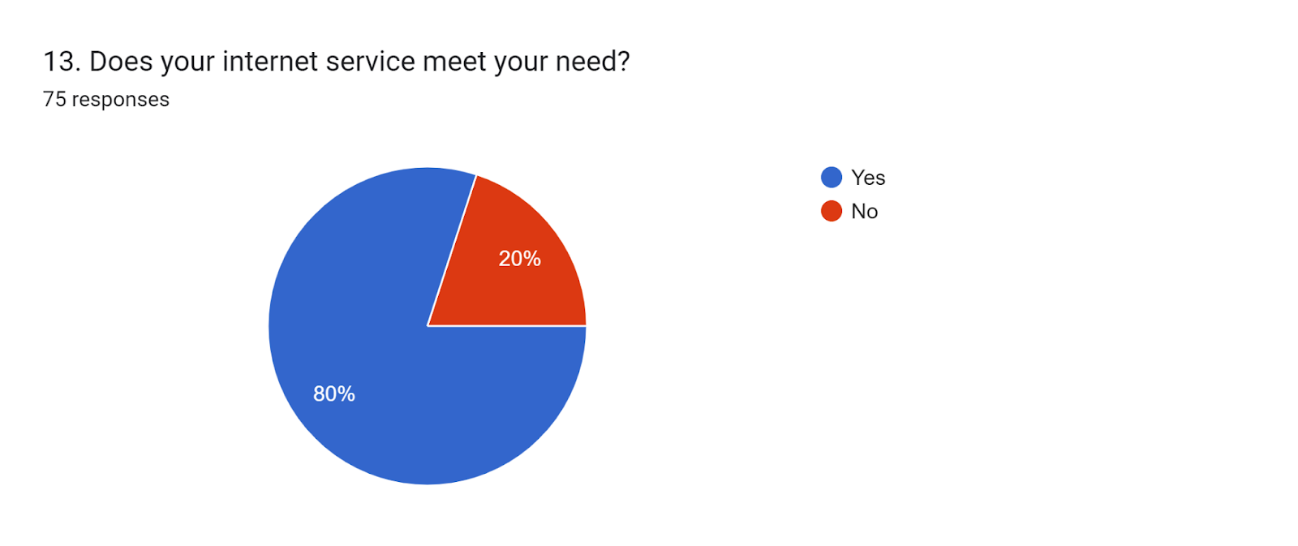

Slide 25


IDENTIFY THE PROBLEMS AND THERE SOLUTIONS
DURING THE SURVEY WE FOUND SOME NETWARK RELATED PROBLEMS SO OUR TEAM SUGGESTED FEW SOLUTIONS TO THEM

Slide 26
Problem
Most of the people using their internet more than two hour
Solution from our side
which is not good for health and also for environment. So, from our point of view using one to two hour internet is enough for all.

Slide 27
Problem
Most of the people not aware about online transaction.
Solution from our side
Now a day online transaction is more useful for all because way of payment becomes easy and no need cash in every place.

Slide 28
Problem
Most of the people not aware about internet security/privacy.
Solution from our side
In those day security is more important because threat is increasing rapidly.

Slide 29
Conclusion
Internet plays an important role to become digital.
Now a days, Approximate 70-80% work is depend on internet like shopping, money transaction, … etc.
Those who are not aware about internet and what are the uses of internet and what is the importance of internet will not survive confidently.
And those who are not knows about internet privacy/security definitely they face lot of problem because now a day threating rate increases day by day.
That’s why we suggest many things to them and help them to aware about internet so that they also use internet properly.

Slide 30


